Slide 1

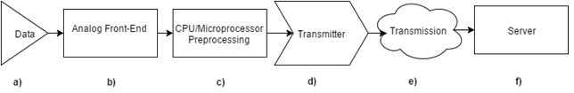
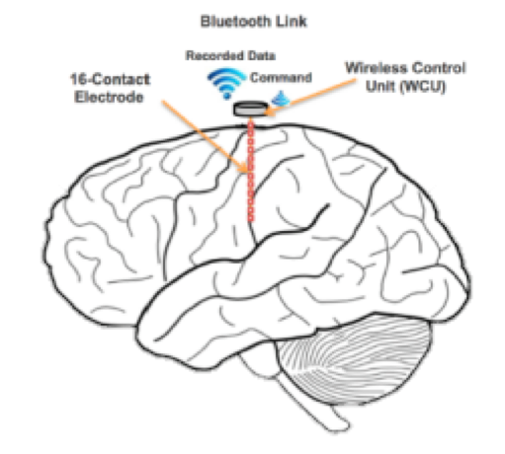
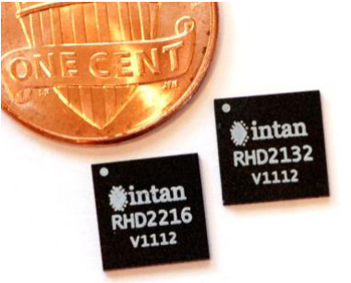


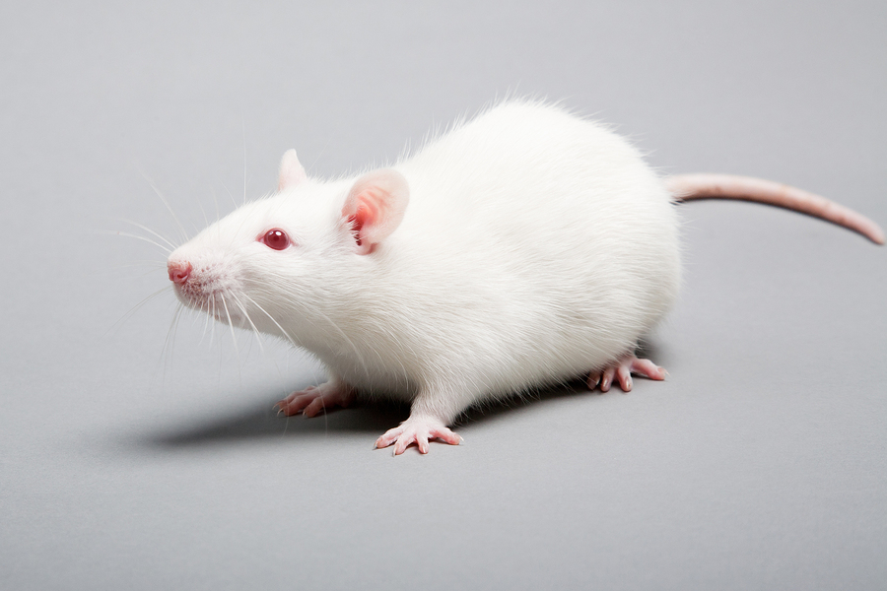
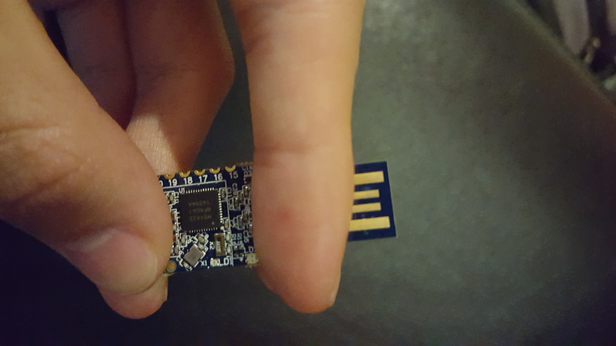




Energy-Efficient High-Throughput Wireless Transmission of Multi-Channel Neuro Signals
Yuan Gao, Tingkai Liu, Xin Huang, Stephen Xia
Department of Electrical and Computer Engineering, Rice University
Project Description
Engineering Design for a Single Wireless Control Unit
Low-power
Wireless array; unrestricted by a physical tether
High throughput
High precision
Small form factor
Currently the market lacks a neural recording device that combines all of these features
System Design Goal
To design a small, power-efficient wireless add-on to neural electrode.
Design Specifications
Electrode Array
Analog-to-Digital Front-End
Bluetooth Low Energy
Server
Array of 16 electrodes
Each electrode outfitted with a wireless control unit (WCU)
Each WCU samples neural data and transmits in real-time to a secure terminal
Intan RHD2000
Specialized neural recording chip
Protective circuitry
Nanovolt precision
Nordic NRF52
Powerful ARM M-4 Processor
Upwards of 2 Mbits/s
Compression
Secure Terminal
Communicates with the BLE transmitters on the probes
Data presentation and analysis
Prototype
Next Steps
Wireless Control Unit Specifications
16 Channel Neural Electrode Sampling
Each channel needs to sampled at 1 kHz
Data fidelity: 8-bit Data Precision
Compact Form Factor: No larger than 15 x 15 x 15 mm
Operating battery life: > 24 hours
Begin small animal testing with functional prototype
Custom IC: ideally should fit within 8 x 8 x 8 mm
WiFi HaLow: Increase data rate beyond BLE products
Areas of Impact
PCB+ELECTRODE Images (When we get them)
Hospitals/Clinics
Research Institutions
Households
Acknowledgements
We would like to thank Rice ECE department members: Dr. Gary Woods, Dr. Aydin Babakhani, Hamed Rahmani and UTHealth Neurosurgeon: Dr. Nitin Tandon, for their technical advice and project support.
Special thanks to the Brenner Foundation with Ellen Kirk and the resources of the Oshman Engineering Design Kitchen. Without them, this project would not be possible.

